Slide 1
Learning and Generalisation in Feed-Forward Networks – from Perceptron Learning to Backprop
Artificla Neural Networks and Deep Architectures – Lab 1
Fredrik Danielsson, Franco Ruggeri

Slide 2
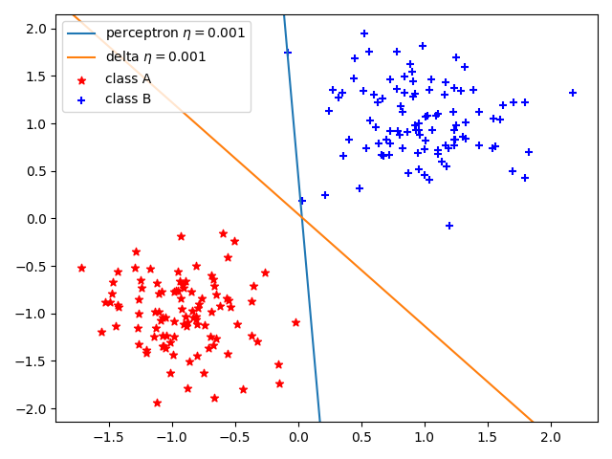
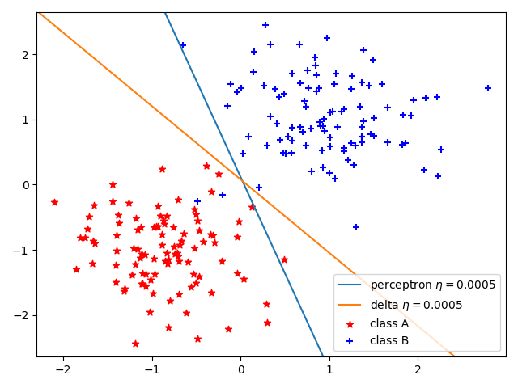
Classification with a Single-Layer Perceptron
Delta rule vs Perceptron learning. Comparison between a linearly separable set (left) and a linearbly unseparable set (right).

Slide 3
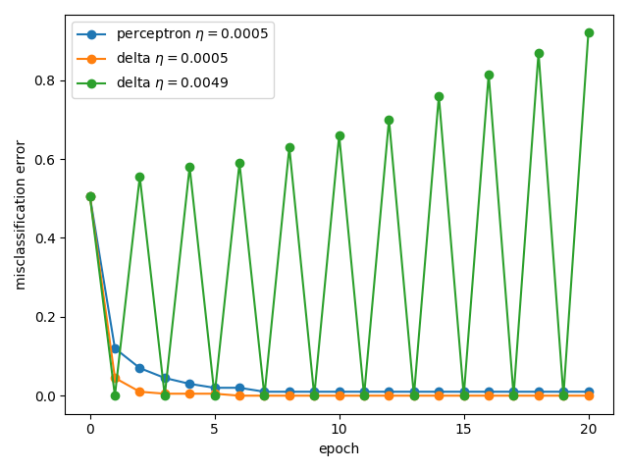
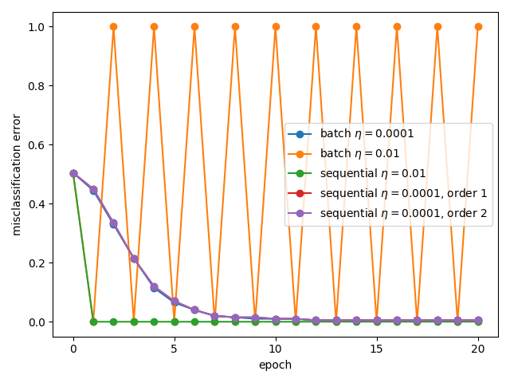
Classification with a Single-Layer Perceptron
Comparison of delta rule and perceptron learning rule (left)
Comparison of batch and sequential modes, in terms of learning curve (right)

Slide 4
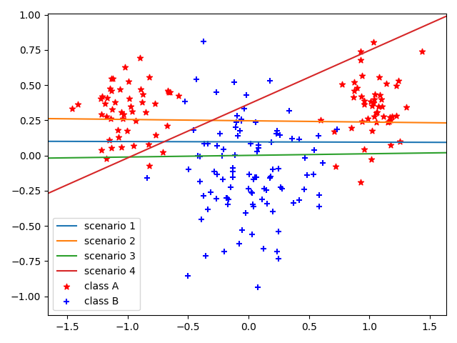
Classification with a Single-Layer Perceptron
Right figure: Decision boundaries of perceptrons, for the different sub-samples of the original data set
Trained with delta rule in batch mode

Slide 5
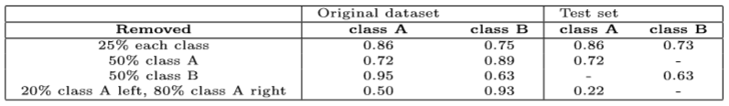
Classification with a Single-Layer Perceptron
Accuracy table computed on the original training set and on the test set
Perceptrons training with a sub-sample of the original data according to the leftmost column of the table
Delta rule in batch mode
Results averaged over 100 different runs

Slide 6
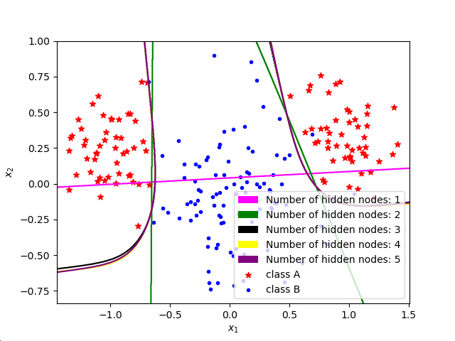
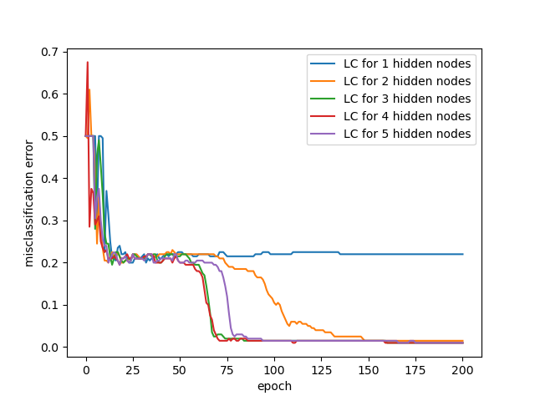
Classification and Regression with a Two-Layer Perceptron
Very poor results with 1 and 2 hidden nodes. Seems to be almost identical going beyond that.

Slide 7
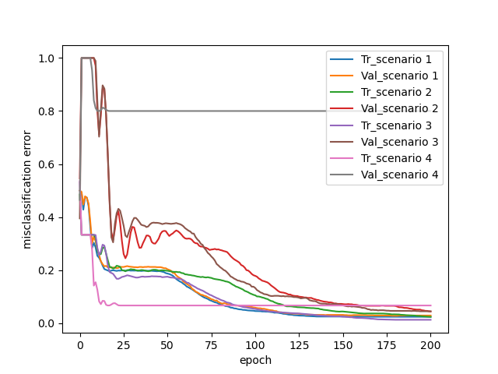
Classification and Regression with a Two-Layer Perceptron
To the right: How the different scenarios differ, averaged over 100 runs
Two clear outliers: Scenario 1 (best) and Scenario 4 (worst)

Slide 8
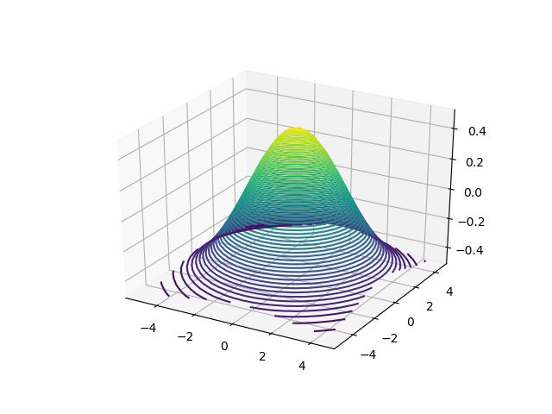
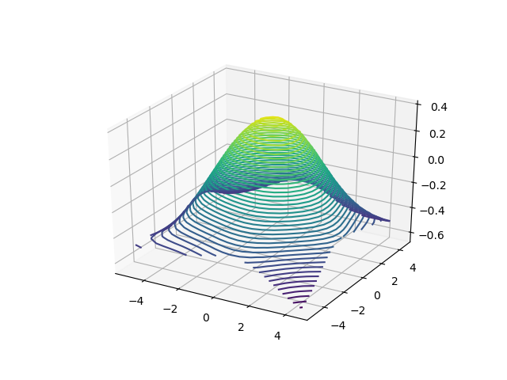
Classification and Regression with a Two-Layer Perceptron
Decent approximation, not great.
One reason could be the high learning rate used (0.5) over 100 epochs
Perhaps not converged enough?

Slide 9
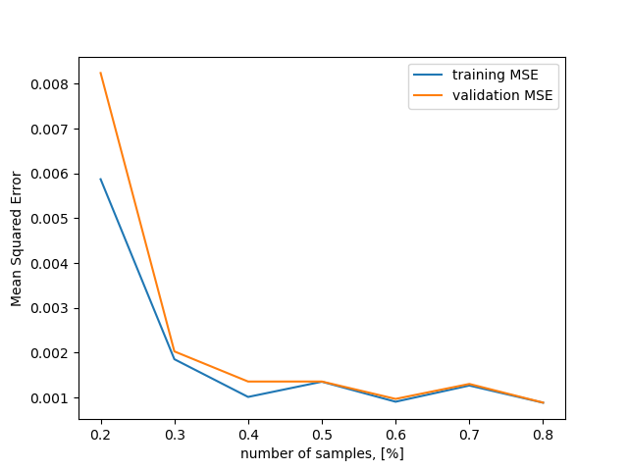
Classification and Regression with a Two-Layer Perceptron
Training vs validation MSE over number of samples [%].
Number of hidden nodes = 25
Learning rate = 0.1
Epochs = 100

Slide 10
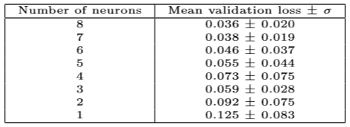
Time Series Prediction – Model Selection, Regularisation and Validation
Regularisation strength set to 0.00001
30 training runs
Single hidden layer

Slide 11
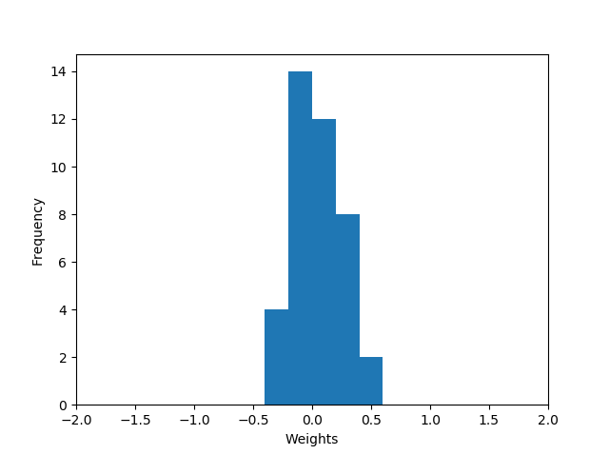
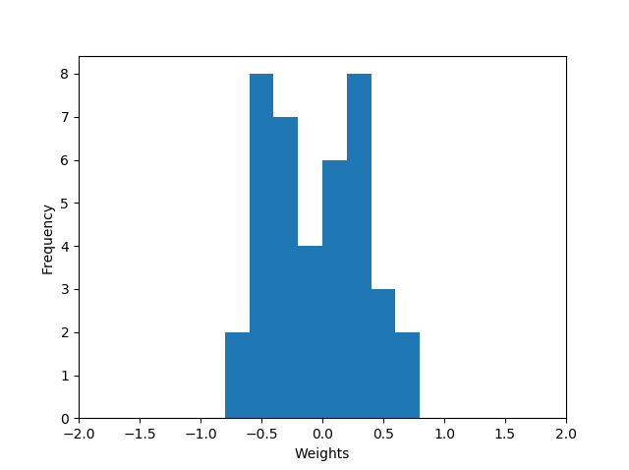
Time Series Prediction – Model Selection, Regularisation and Validation
Regularisation parameter set to 0.01 (left) and 0.00001 (right)
Lower value → wider distribution
Higher value → thinner distribution

Slide 12
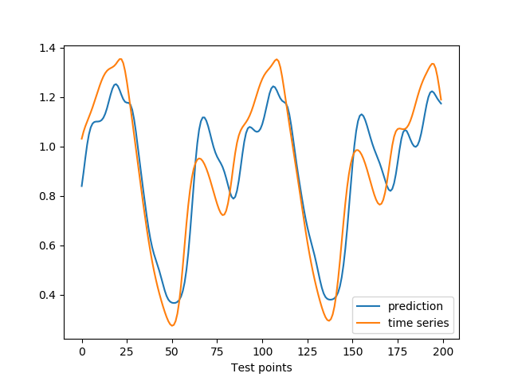
Time Series Prediction – Model Selection, Regularisation and Validation
The prediction is pretty decent, basically the same inflection points but looks slightly shifted
Final configuration: 8 neurons, with regularization parameter set to 0.00001
Final MSE: 0.0166 ± 0.003

Slide 13
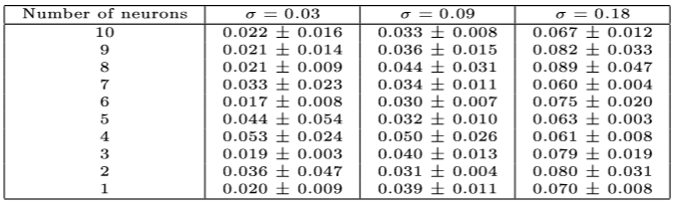
Comparison of Two- and Three-Layer Perceptron for Noisy Time Series Prediction
Tables for two-layer perceptron (left) and three-layer perceptron (right)
Left table has no Gaussian noise
While right table has different levels of additive Gaussian noise
Single-Layer Perceptron

Slide 14
THANK YOU!

